Slide 1
Lecture 22
Peterson Solution
National University of
Computer & Emerging Sciences

Slide 2
Peterson’s Solution
    Combine the previous two algorithms:
    int turn;
    bool interested[2];
Interested[0] = FALSE
  Process 0 is not interested
Interested[0] = TRUE
  Process 0 is interested
Interested[1] = FALSE
  Process 1 is not interested
Interested[1] = TRUE
  Process 1 is interested

Slide 3
Peterson's Algorithm
Shared variables are created and initialized before either process starts.
The shared variables flag[0] and flag[1] are initialized to FALSE because neither process is yet interested in the critical section.
The shared variable turn is set to either 0 or 1 randomly (or it can always be set to say 0).
repeat
flag[i] := TRUE;
turn := j;
while (flag[j] and turn=j) do no-op;
CRITICAL SECTION
flag[i] := FALSE;
REMAINDER SECTION
until FALSE;
Information common to both processes:
turn = 0
flag[0] = FALSE
flag[1] = FALSE

Slide 4
Peterson’s Solution
Process 0
while(TRUE)
{ interested[0] = TRUE;
turn = 1;
// wait
while(interested[1]==TRUE && turn == 1 );
F && T
interested[0] = FALSE;
noncritical_section();}
critical_section();
Timeout
Process 1
while(TRUE)
{
interested[1] = TRUE;
turn = 0;
// wait
while(interested[0]==TRUE && turn == 0 );
T && T
F && T
critical_section();
interested[1] = FALSE;
noncritical_section();
}

Slide 5
Peterson’s Solution
Process 0
while(TRUE)
{ interested[0] = TRUE;
turn = 1;
// wait
while(interested[1]==TRUE && turn == 1 );
T && F
interested[0] = FALSE;
noncritical_section();}
critical_section();
Timeout
Process 1
while(TRUE)
{
interested[1] = TRUE;
turn = 0;
// wait
while(interested[0]==TRUE && turn == 0 );
Can not be TRUE at the same time.
Thus used to break tie
T && T
F && T
critical_section();
interested[1] = FALSE;
noncritical_section();
}

Slide 6
Proof of three properties
Mutual exclusion is preserved since:
  P0 and P1 are both in CS only if flag[0] = flag[1] = true and only if turn = i for each Pi (impossible)
We now prove that the progress and bounded waiting requirements are satisfied:
  Pi cannot enter CS only if stuck in while() with condition flag[ j] = true and turn = j.
  If Pj is not ready to enter CS then flag[ j] = false and Pi can then enter its CS
  If Pj has set flag[ j]=true and is in its while(), then either turn=i or turn=j
  If turn=i, then Pi enters CS. If turn=j then Pj enters CS but will then reset flag[ j]=false on exit: allowing Pi to enter CS
  but if Pj has time to reset flag[ j]=true, it must also set turn=i

Slide 7
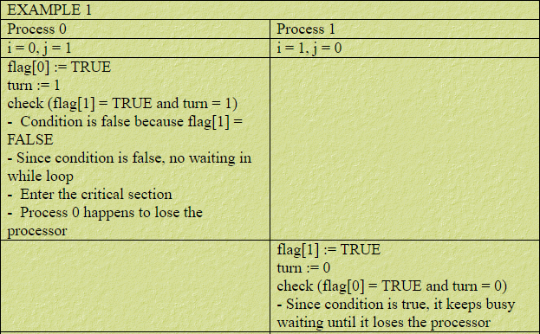
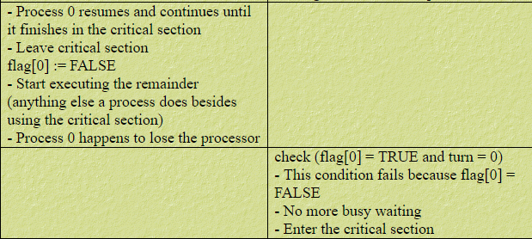
Peterson solution Dry Run1

Slide 8
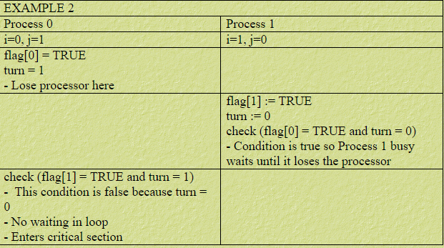
Peterson solution Dry Run2

Slide 9
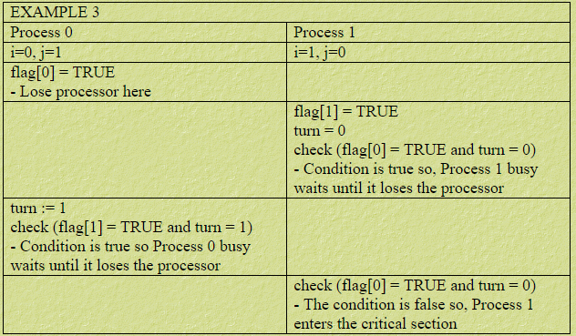
Peterson solution Dry Run3

